Slide 1
Mission: PODRUŽNIČARJI GREMO NAPREJ (Branch schools are moving forward)
Ms Marjana Marn, project leader

Slide 2
Why did we choose this project?
uniqueness of branch schools
2007-2013 project “Branch school – the engine of progress“
an intergenerational centres of local life and development
2014-2020 project “Branch schools are moving forward”

Slide 3
Our partners
Leading partner:
Primary School Sostro with branch
schools in Besnica, Janče, Lipoglav and Prežganje.
Partners:
- Kindergarten Pedenjped, unit Janče,
- Tourism Association Besnica – Janče,
- Sports Association Janče.

Slide 4
Our goals:
greater social inclusion
preservation and protection of natural features and biotic diversity
gaining practical experience in a sustainable way of life
creating an attractive living environment and raising the quality of living
intergenerational cooperation

Slide 5
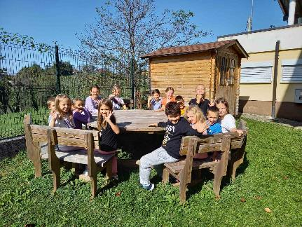
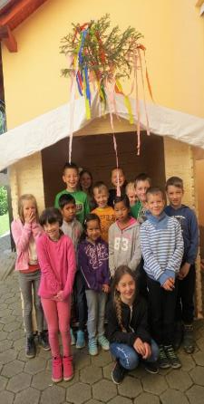
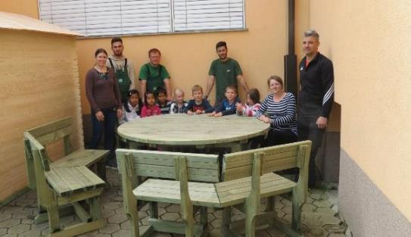
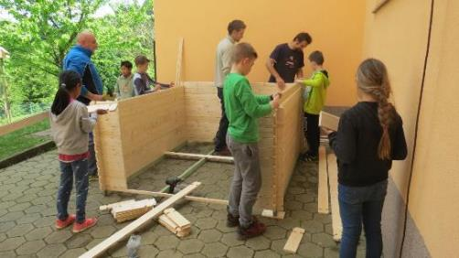
Activities to achieve our goals:
BUILDING AND INSTALLATION
OF GARDEN SHEDS AND
OUTDOOR BENCHES

Slide 6
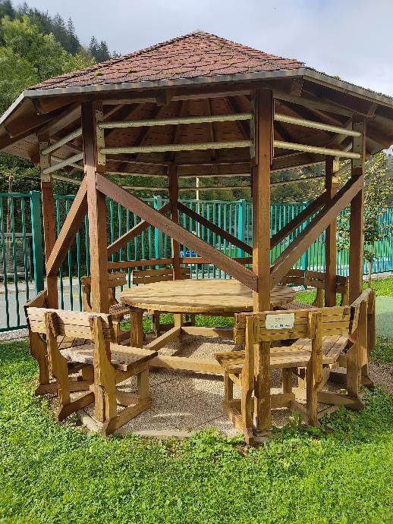
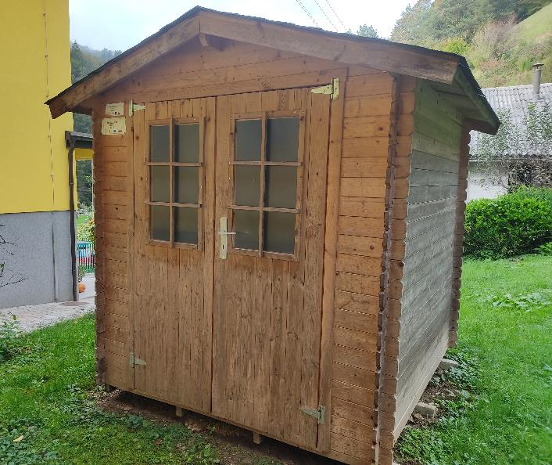

Slide 7
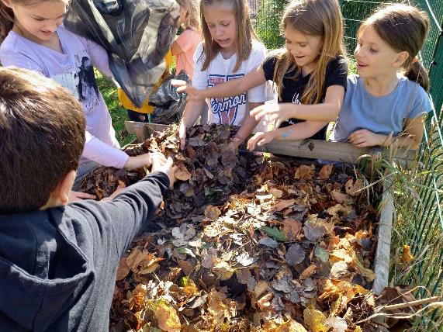
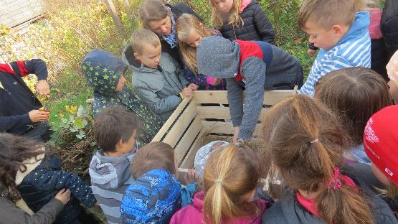
INSTALLATION OF COMPOST BINS

Slide 8
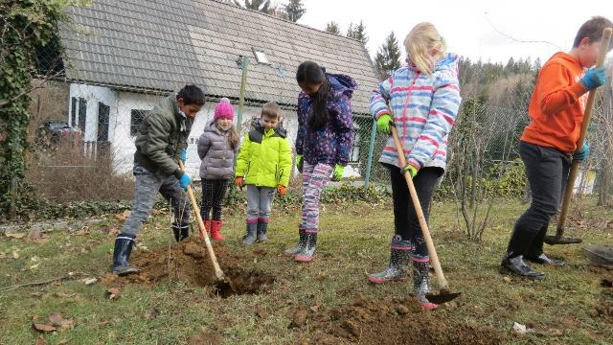
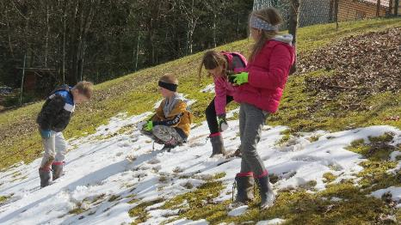
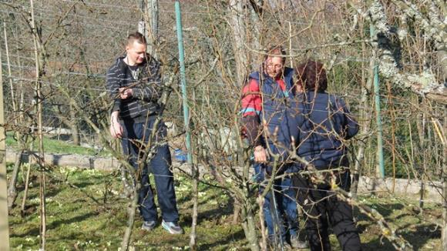
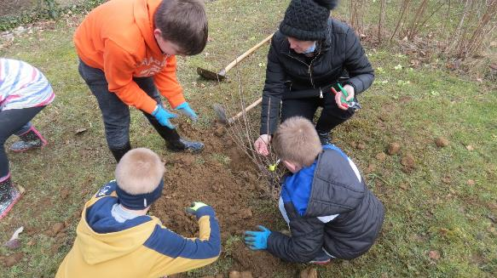
TAKING CARE OF ECO ORCHARD

Slide 9
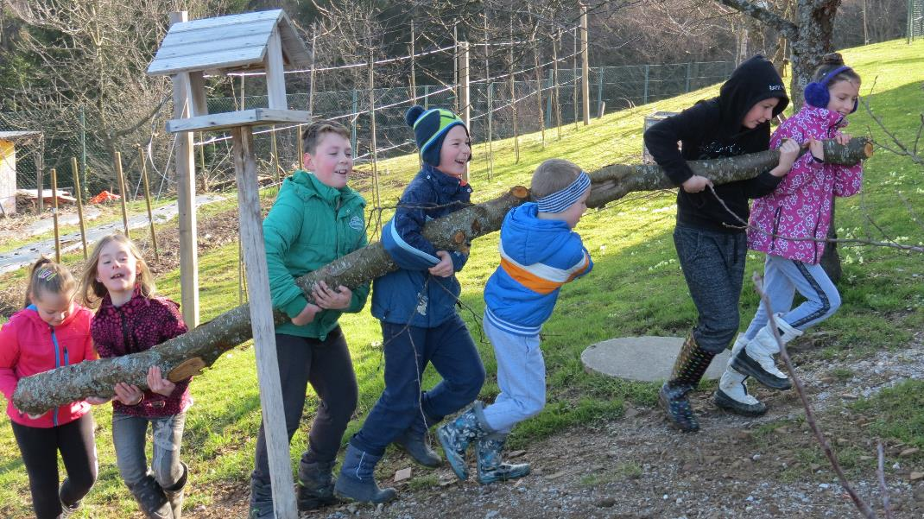

Slide 10
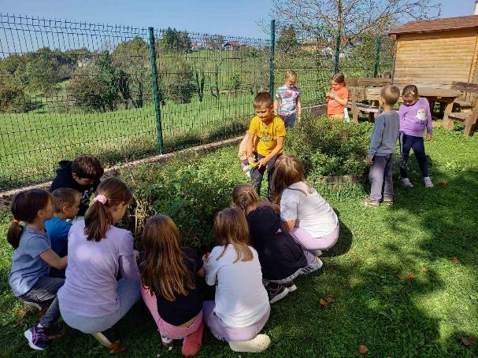
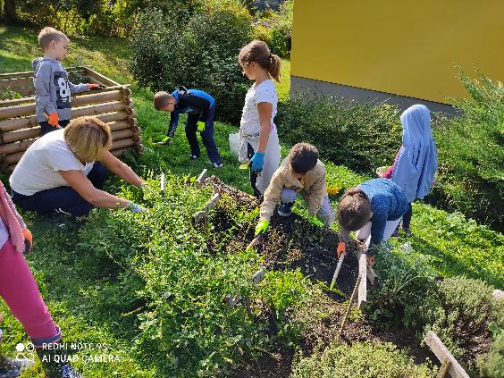
ECO ORCHARDS made in the project
Branch school in Besnica
Branch school in Lipoglav

Slide 11
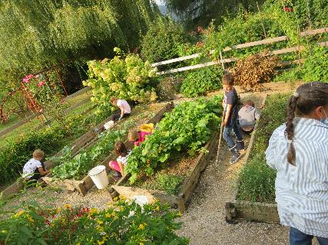
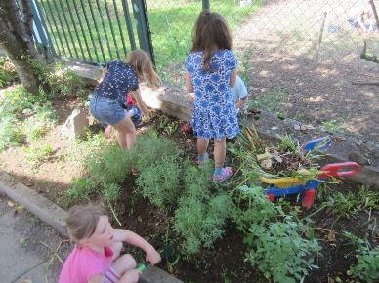
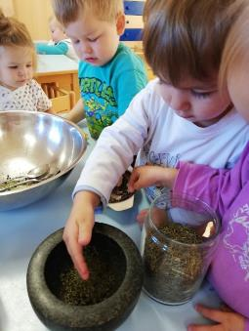
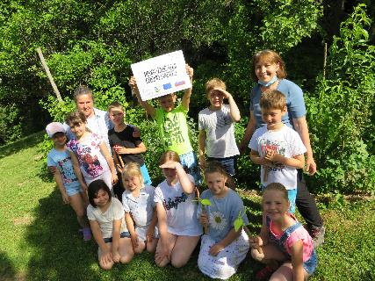
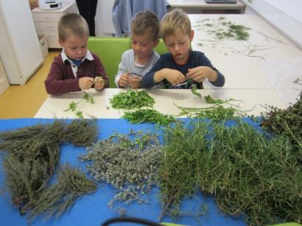
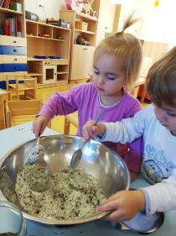
Branch school in Prežganje
Kindergarten PEDENJPED, Unit Janče

Slide 12
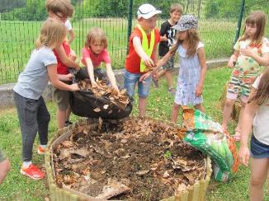
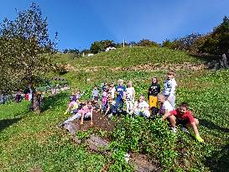
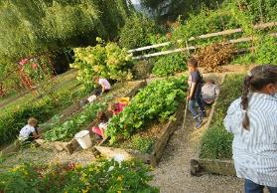
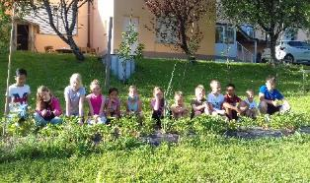
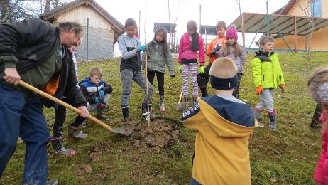
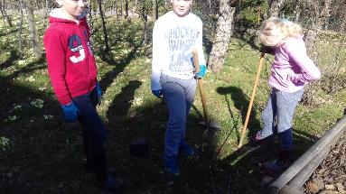
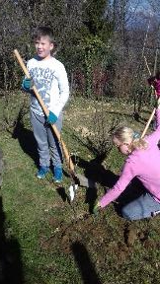
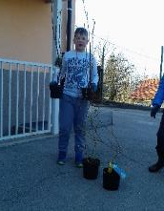
ARRANGEMENT AND MAINTENANCE OF ECOGARDENS AT BRANCH SCHOOLS AND IN KINDERGARTEN
PLANTING OF FRUIT TREES AND SHRUBS

Slide 13
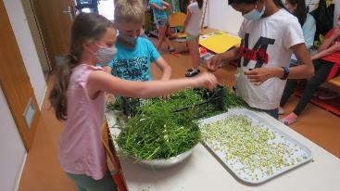
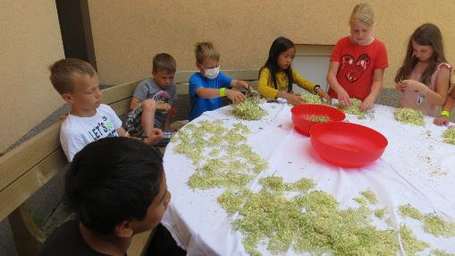
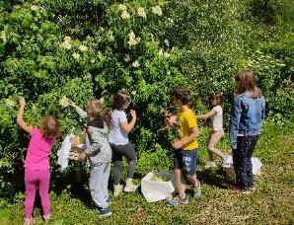
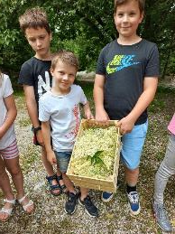
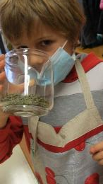
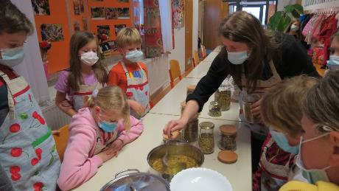
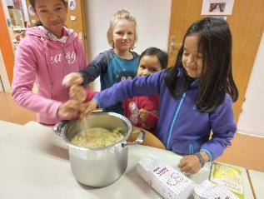
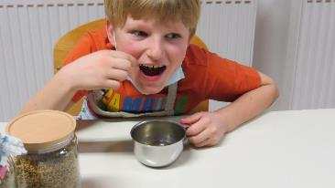
COLLECTION OF HERBS FOR DRYING AND TEA
MAKING OF SYRUP

Slide 14
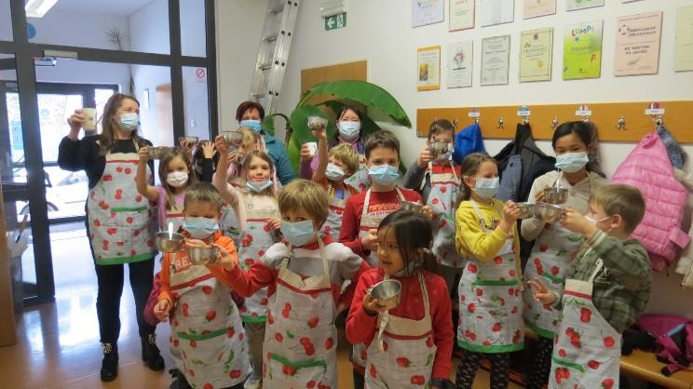
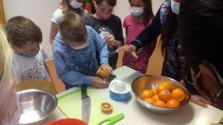
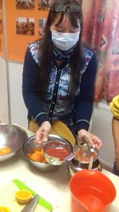
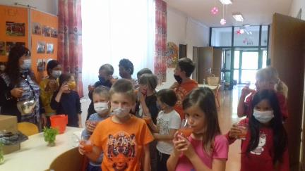
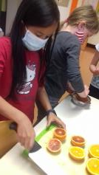
PACKING OF TEA IN BAGS
PREPARING TEA
MAKING JUICE

Slide 15
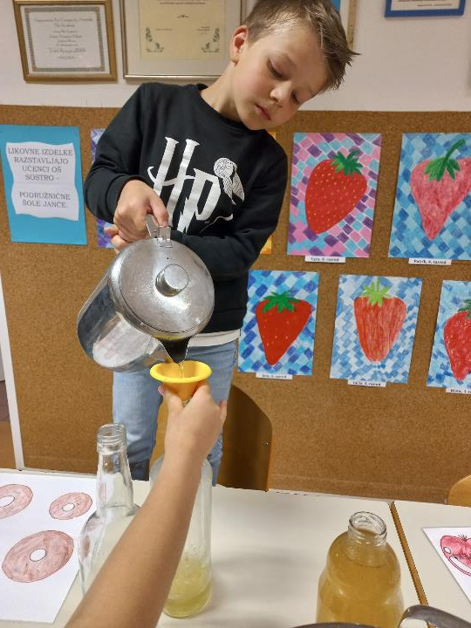
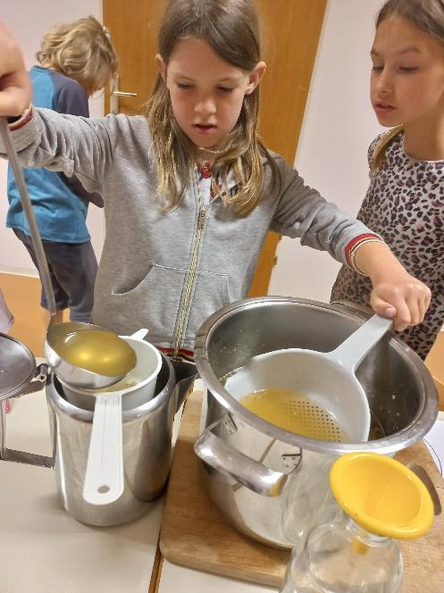
MAKING OF SYRUP

Slide 16
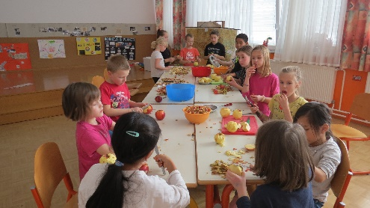
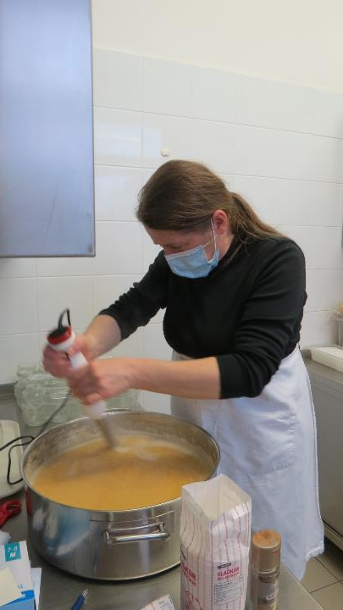
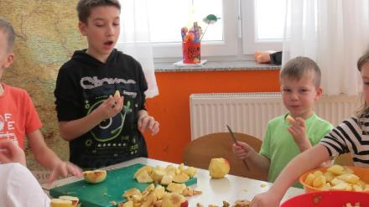
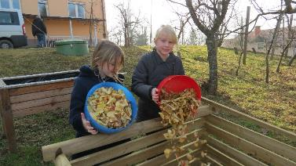
MAKING HOME MARMELADE

Slide 17
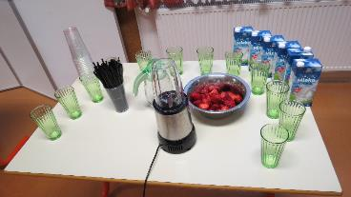
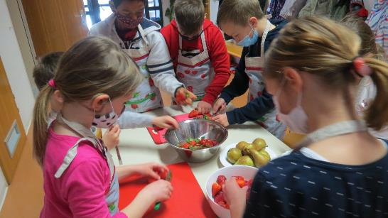
MAKING SMOOTHIES

Slide 19
ARRANGING GIFTS FOR THE ELDERLY

Slide 20
Povzemanje
Preglejte zamisli.
Izberite najboljše kandidate in se posvetujte.
Preverite zahteve in omejitve.
Skrajšajte seznam na najboljših 5–10 zamisli.

Slide 21
MAKING CRATES

Slide 22
MAKING SIGNS

Slide 23
GAMES WITHOUT
LIMITS

Slide 24
MEETING THE ELDERS (HOME VISITIS)

Slide 25
New products:

Slide 26
Promoting the project:

Slide 28
Direct results achieved:
5 herb and vegetable beds
three garden sheds
4 sets of outdoor benches
tour of the herb garden (Grum farm)
training for teachers and members of associations
55 different workshops for children
4 meetings with the elderly and 4 visits to the elderly at homes
games without limits
More than 200 children under the age of 10, 25 children over the age of 10 and 46 elderly people were included.

Slide 29
Indirect results achieved:
improving children's positive emotional attitude towards nature
improvement of ecological awareness
acquired work habits
intergenerational cooperation
the shortest food chains
new local product: cloth gift bag filled with dried herbs for tea
cross-sectoral and all-generational integration

Slide 30
Sources of funding:
Co-funding from EKSRP in worth of 34.368,67 €.
Total worth of the project: 49.833,56 €.

Slide 31
Behind this success story are the headmistress Mojca Pajnič Kirn, who wholeheartedly supports projects that enrich children's activities and teach them for life, as well as warm-hearted teachers at branch schools of the Municipality of Ljubljana.

